Slide 1

BYA Bitvavo
Long-Term Analysis
April - May 2024

Slide 2
Summary & Recommendations (in progress)
User Retention: 61% of depositors have not withdrawn any amount since depositing, indicating strong retention overtime.
Summary post-campaign analysis

Slide 3
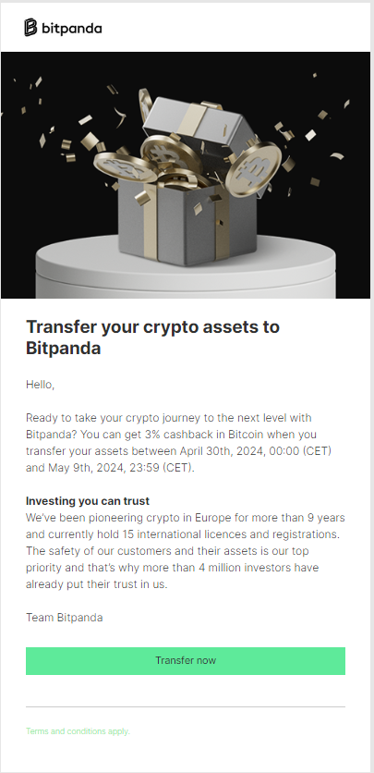
Overview
Email
3,368
Users (Depositors)
€636,006
Cashback (Paid)
€2,049,014
Summary post-campaign analysis
Revenue
226%
ROI

Slide 4
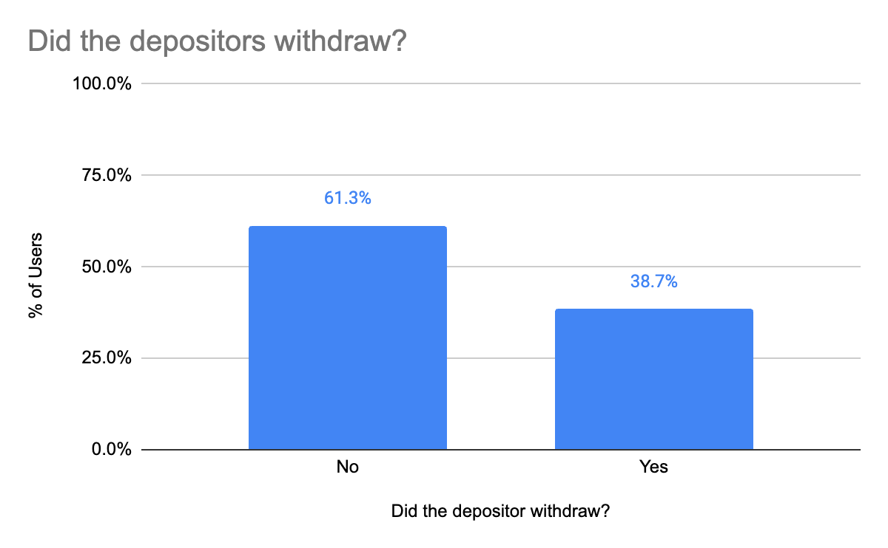
1. Did the depositors withdraw?
Around 61% didn't withdraw any amount since the deposit, while 38.7% did
Summary post-campaign analysis

Slide 5
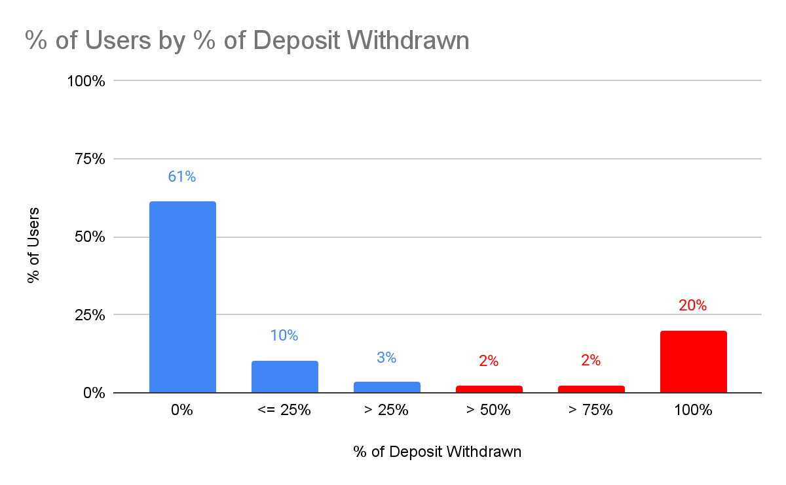
1. Did the depositors withdraw?
a. What's the distribution?
24% of the depositors withdrew at least 50% of the deposited amount, while 71% withdrew (or didn't at all) 25% or less
Summary post-campaign analysis
24%
20% of the users withdrew the total amount it was deposited, while 61% kept the deposited amount in Bitpanda

Slide 6
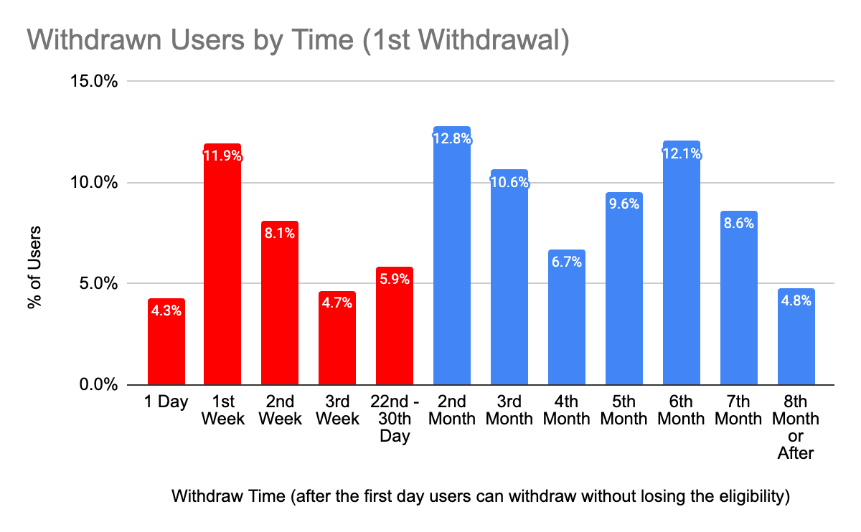
1. Did the depositors withdraw?
b. How long did it take for the users start withdrawing?
Just depositors that withdrew 50% or more and 1st withdrawals considered
34.9%
Summary post-campaign analysis
34.9% of the depositors withdrew within the 1st month after gaining eligibility

Slide 7
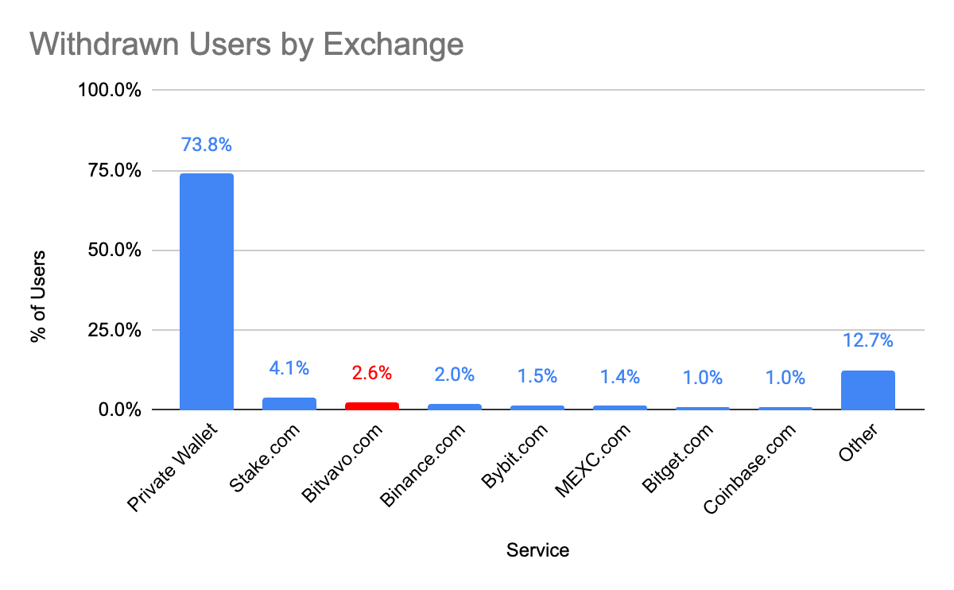
1. Did the depositors withdraw?
c. Where did the withdrawal go? By Service
73.8% of the total withdrawal were sent to private wallets, while 26.2% were sent to other services
Summary post-campaign analysis
2.6% returned to Bitvavo after the promotion, indicating that some users took advantage of the campaign

Slide 8
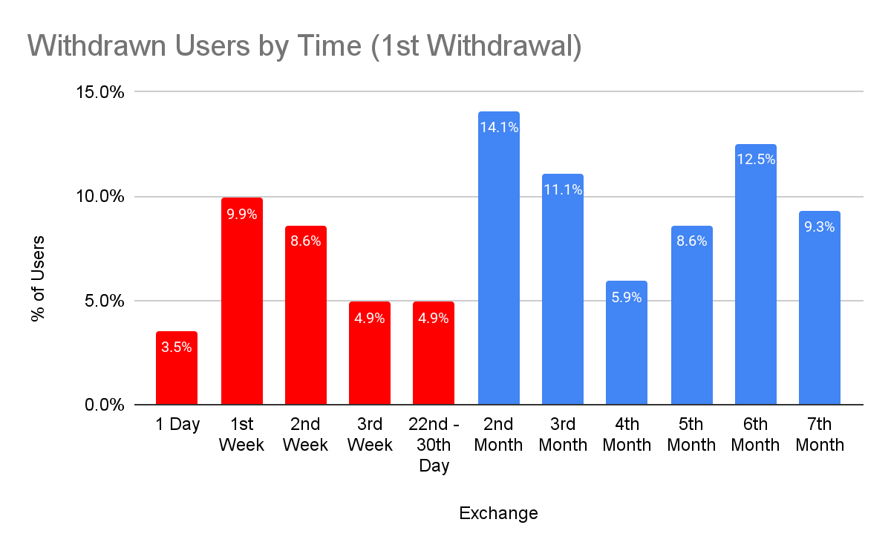
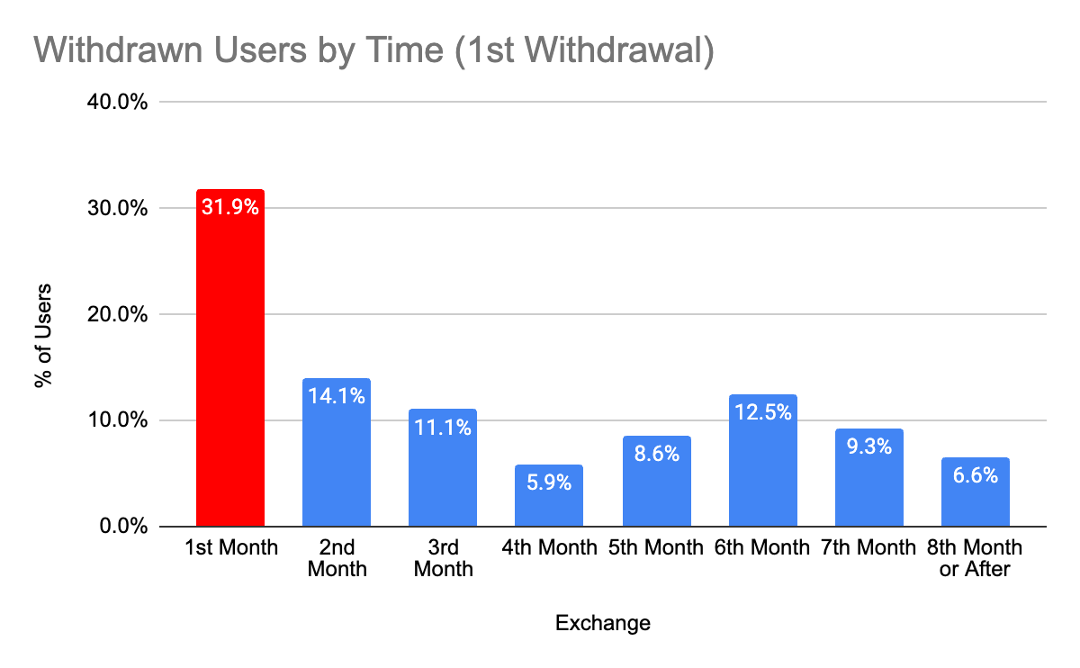
1. Did the depositors withdraw?
d. How long did it take for the users start withdrawing?
Just depositors that withdrew and 1st withdrawals considered
32%
Summary post-campaign analysis
13.4% of the withdrawers started withdrawing within the 1st week they were eligible to.

Slide 9
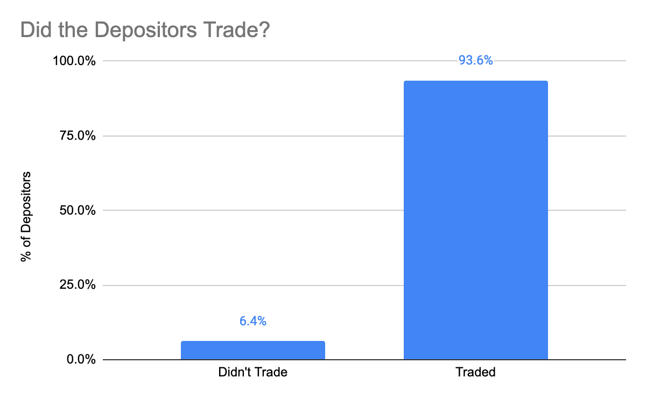
2. Did the depositors trade after depositing?
93.6% of the users traded after depositing within the campaign, while 6.4% didn’t
Summary post-campaign analysis

Slide 10
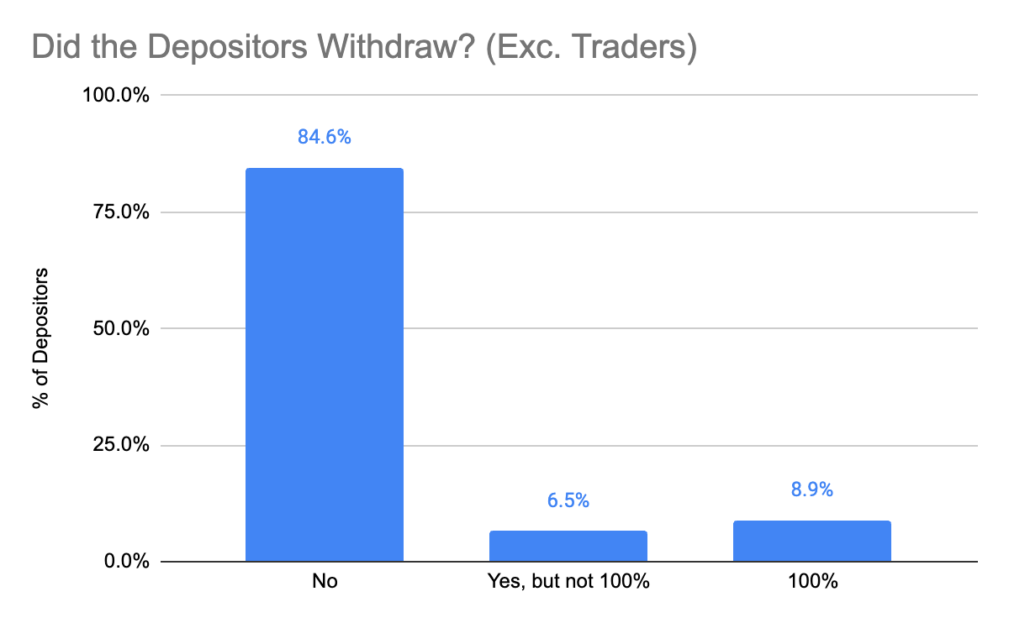
2. Did the depositors trade after depositing?
a. From those who didn’t trade, did they withdraw?
From the 6.4% that didn’t trade, 84.6% didn’t withdraw, while 15.4% made withdrawals - but only 8.9% withdrew the total amount
Summary post-campaign analysis

Slide 11
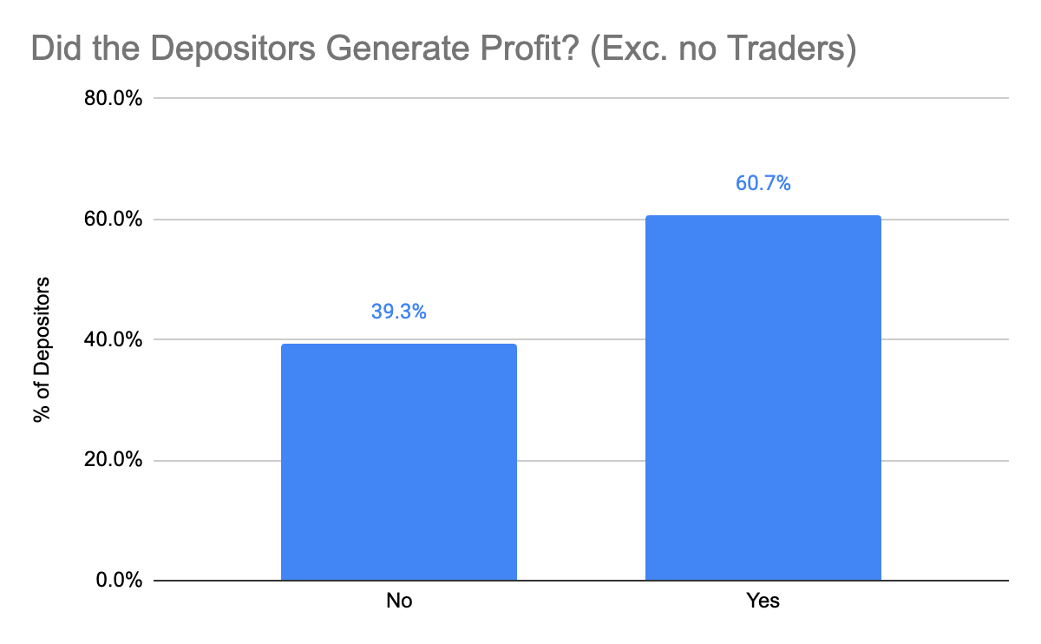
3. Did the depositors generate profit to Bitpanda?
Exc. no Traders (Traders represent 93.6% of the users)
60.7% of the users generated profit to Bitpanda, that’s, generated more in trade fees than received in cashback within the campaign
Summary post-campaign analysis

Slide 12
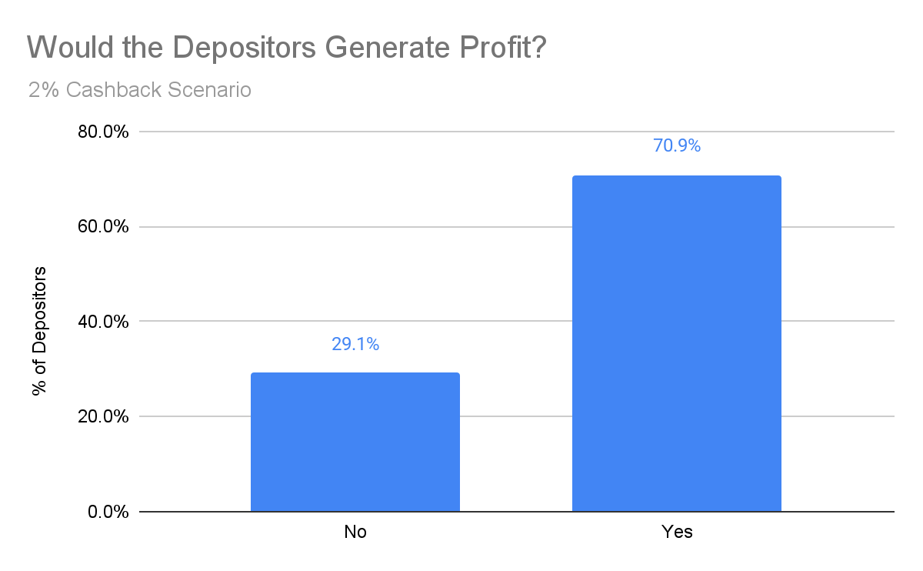
3. Did the depositors generate profit to Bitpanda?
a. Would the depositors generate profit if the cashback was 2% instead of 3%?
Exc. no Traders (Traders represent 93.6% of the users)
70.9% of the users would generate profit in a 2% Cashback scenario, against 60.7% of a 3% cashback, an increase of 10.2p.p.
Summary post-campaign analysis

Slide 13
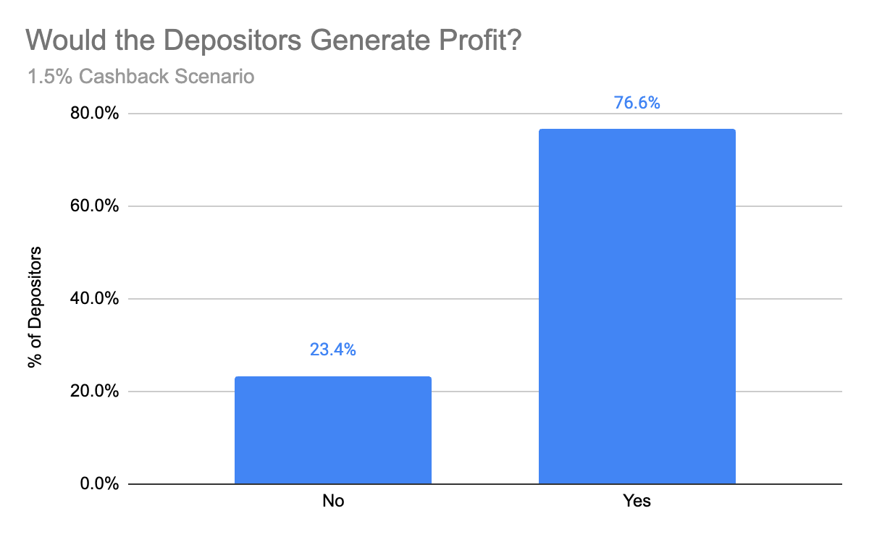
3. Did the depositors generate profit to Bitpanda?
b. Would the depositors generate profit if the cashback was 1.5% instead of 3%?
Exc. no Traders (Traders represent 93.6% of the users)
76.6% of the users would generate profit in a 1.5% Cashback scenario, against 60.7% of a 3% cashback, an increase of 14.9p.p.
Summary post-campaign analysis

Slide 14
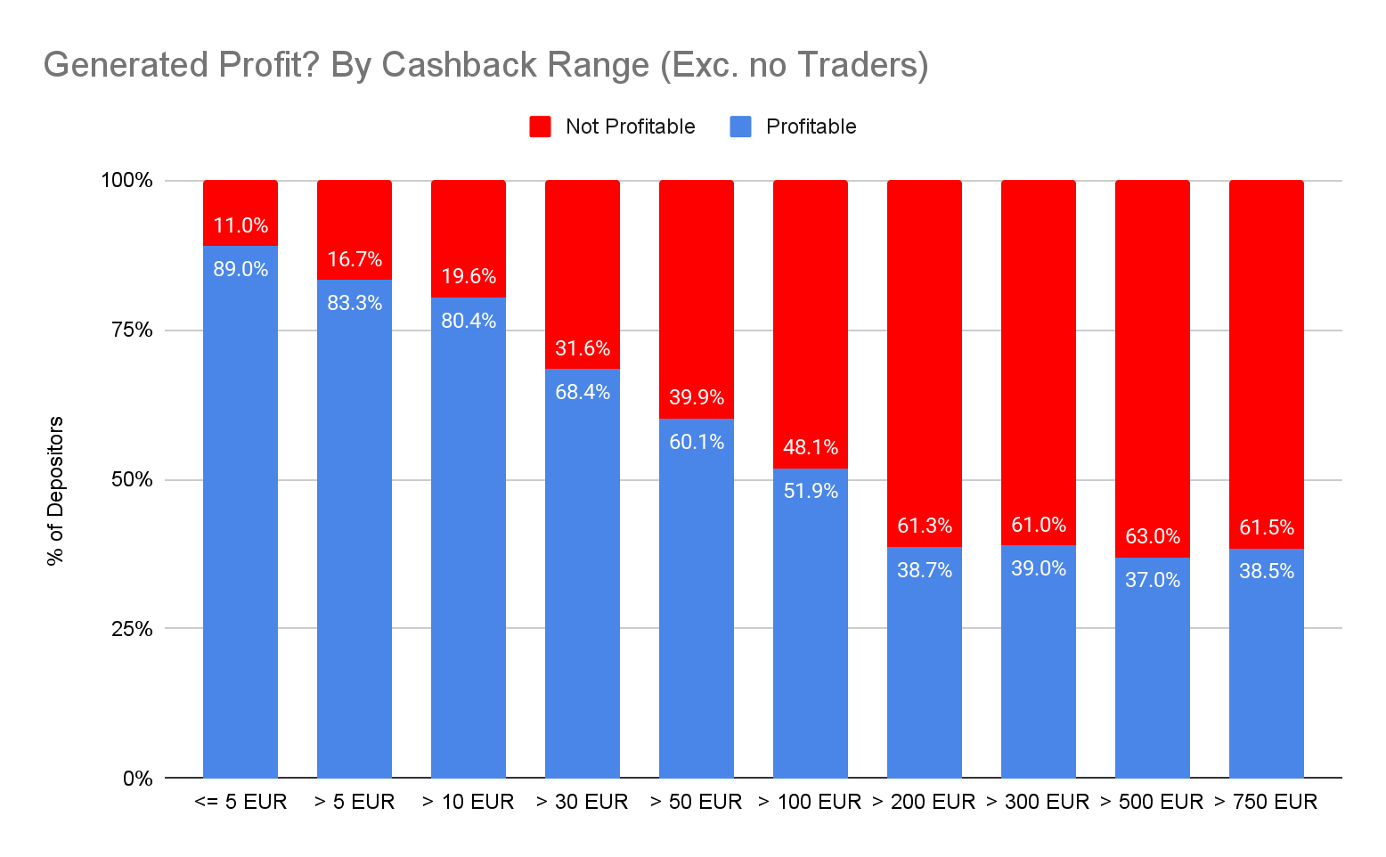
3. Did the depositors generate profit to Bitpanda?
c. Is there a range of cashback that users generated profit more easily?
Exc. no Traders (Traders represent 93.6% of the users)
As higher as the cashback earned gets, it turns to be harder to generate profit within this campaign. While that, amounts smaller than 100 EUR usually generate profit.
Summary post-campaign analysis

Slide 15
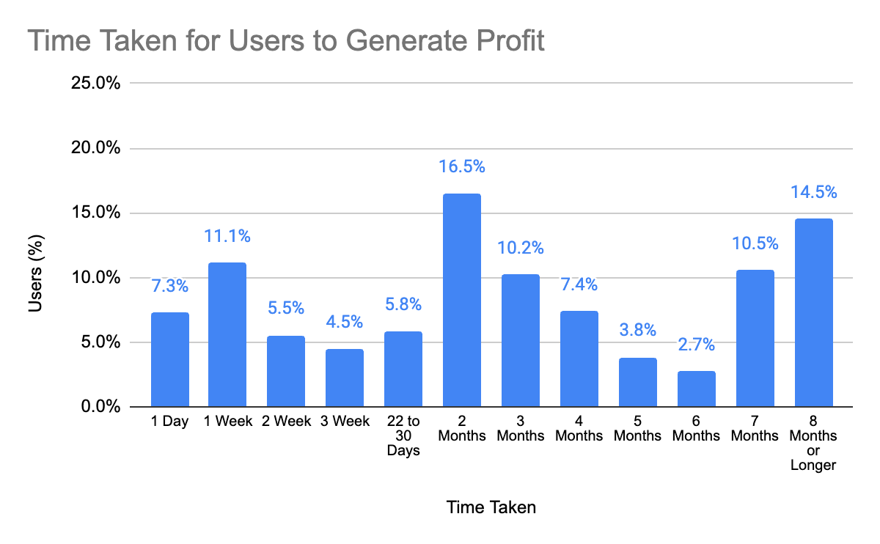
3. Did the depositors generate profit to Bitpanda?
d. How long did the depositors take to generate profit to Bitpanda?
Exc. Depositors that didn’t generate profit
34.2% of the depositors generated profit within the first month after the deposit, while 49.1% took 3 months or longer
Summary post-campaign analysis

